Slide 1
Capacity building for an effective energy transition and climate neutrality in 8 European municipalities
Arantza López, Tecnalia
Urban Transitions 2022
Session 14: Energy and transport
08/11/2022 16:45-17:00

Slide 2
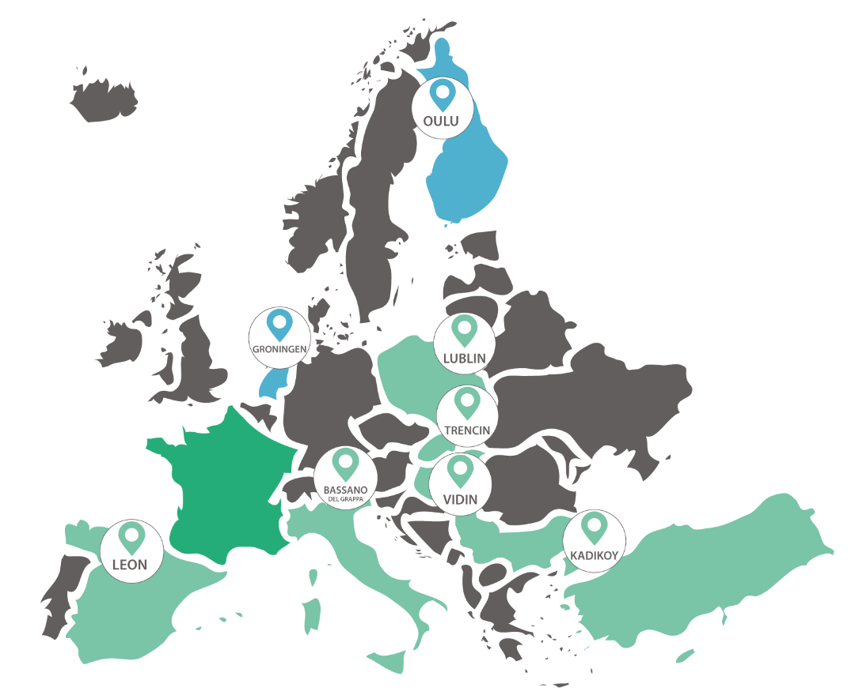
Oulu, Finland
Groningen, The Netherlands
Lublin, Poland
Trencin, Slovakia
Vidin, Bulgaria
Bassano, Italy
Kadikoy, Istambul
León, Spain

Slide 3
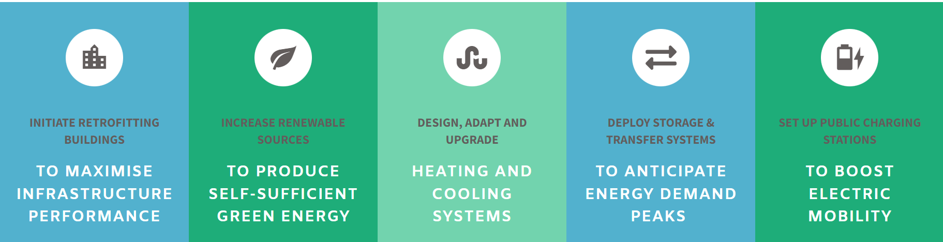
The PED concept
A district with annual net zero energy import and net zero carbon emissions, working towards an annual local surplus production of renewable energy

Slide 4
Energy Transition towards City Vision 2050
Long term vision for a successful PED implementation
Energy plans for energy transition designed within a 2030 horizon (mid-term strategy)

Slide 5
DIKW+E pyramid
Data science
Model
Wisdom
Applied knowledge
Information
Meaningful Data
Data
Facts
Knowledge
Organised information
Enlightenment
Clarity of perception
Learn
Monitoring
Optimized
Applied
Decision-making
High- value proposition
Context
Diagnosis, scenario
Performance management
Meaning
Information process
Raw
Data
Data sources

Slide 6
Implementation
It is needed to capacitate the municipalities to tackle the challenges that face in their everyday activities by adopting a holistic, coordinated, multi-dimension and integrated approach.

Slide 7
Approach to Capacity Building
1. Policy Capacity Analysis & Map | Building on information gathered from a questionnaire and interviews, a Capacity Building Map is developed.
2. Capacity Building Strategy | A strategy is formulated based on the outcomes of the capacity analysis, for each city, contingent to the contextual setting.
3. Capacity Building Toolbox | A toolbox is be developed for each individual city to support their capacity building strategy and a successful energy transition plan implementation.

Slide 8
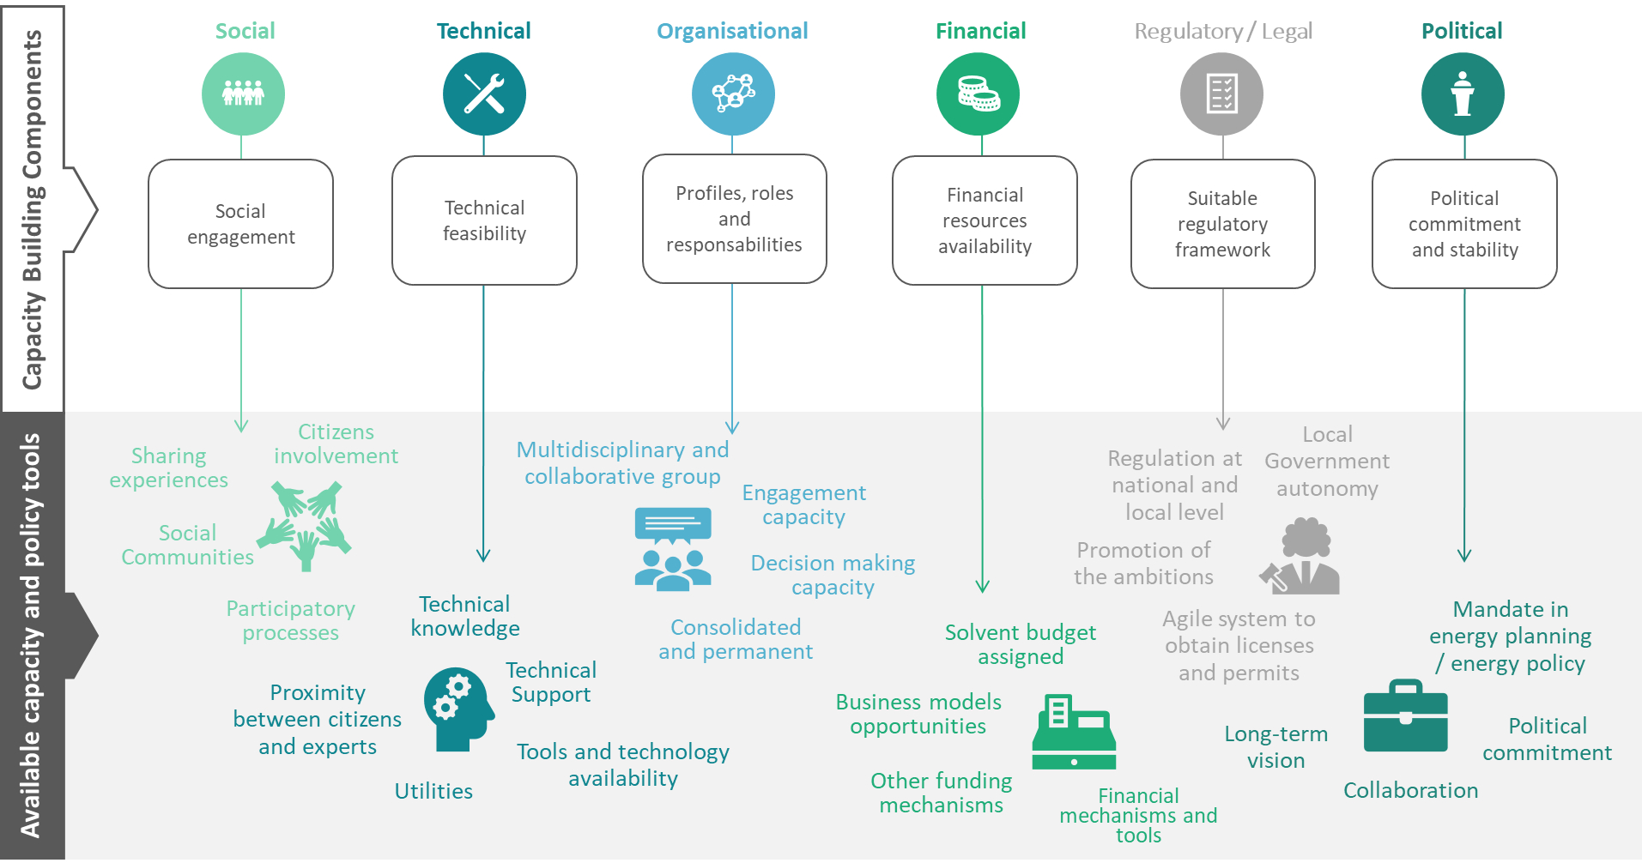

Slide 9
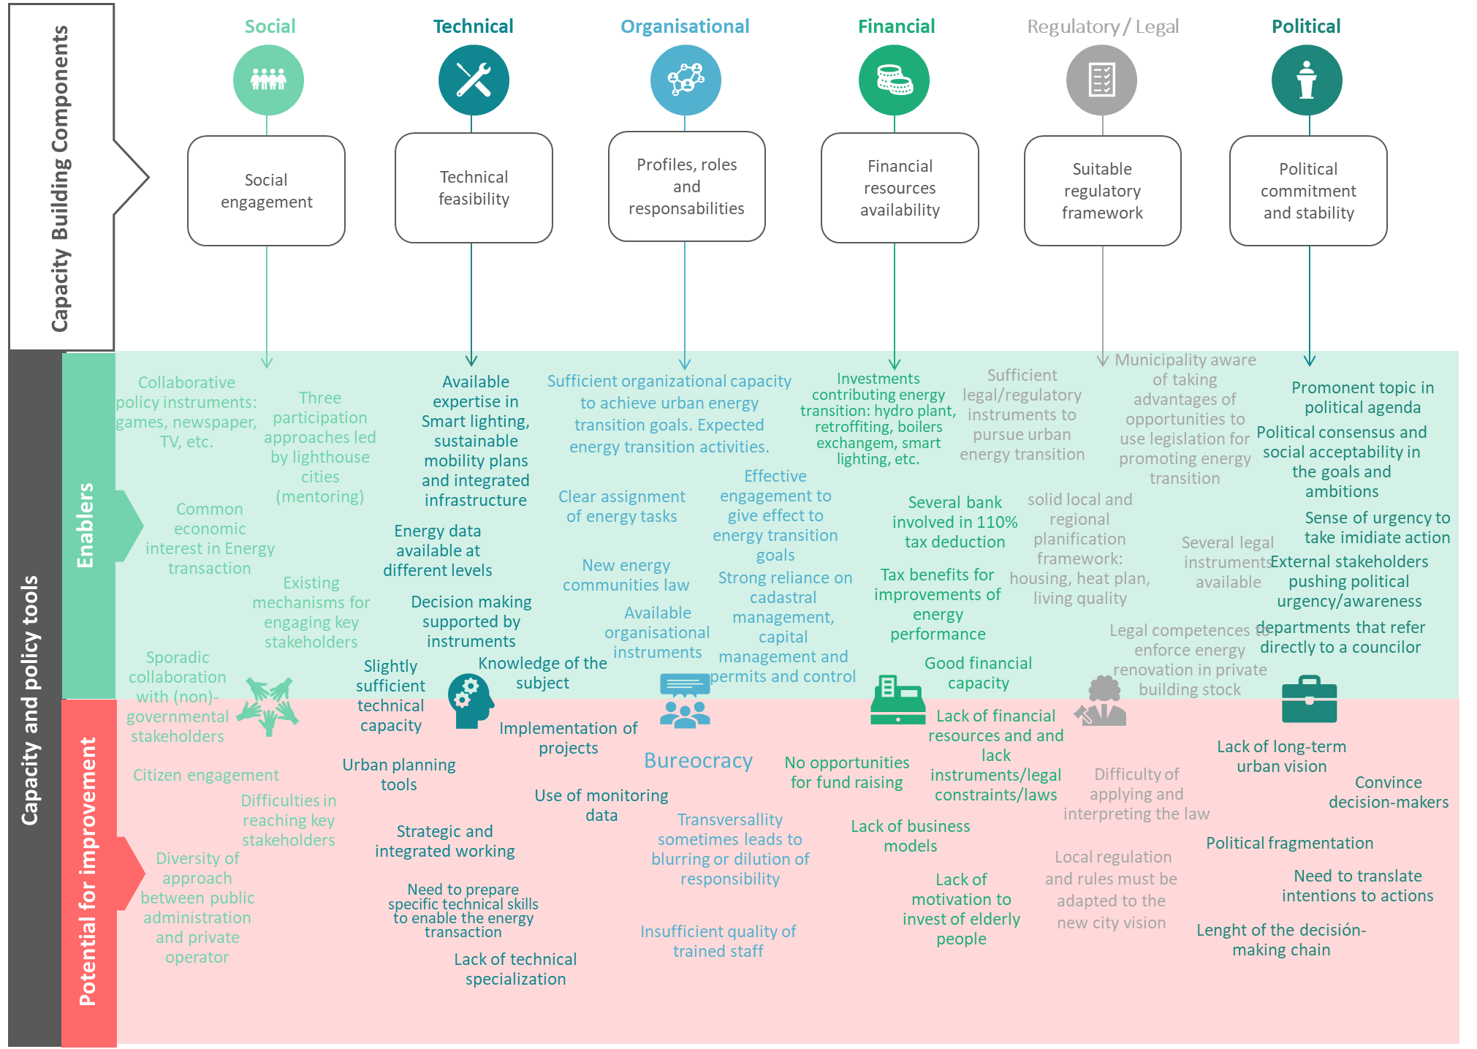

Slide 10
Capacity Building Strategy
Further integrate energy transition goals into local policy areas.
  Develop a strategic spatial energy planning framework.
  Promote wellbeing and the energy transition by integrating energy and social policies.
Establish a district spatial Energy planning practice.
Encourage collaboration on the Energy transition with citizens and companies.

Slide 11
Capacity Building Toolbox
The mix of policy instruments used by City to promote the local energy transition
Category | Instrument name | Instrument description | Effect on local energy transition (somewhat, reasonably, considerably)

Slide 12
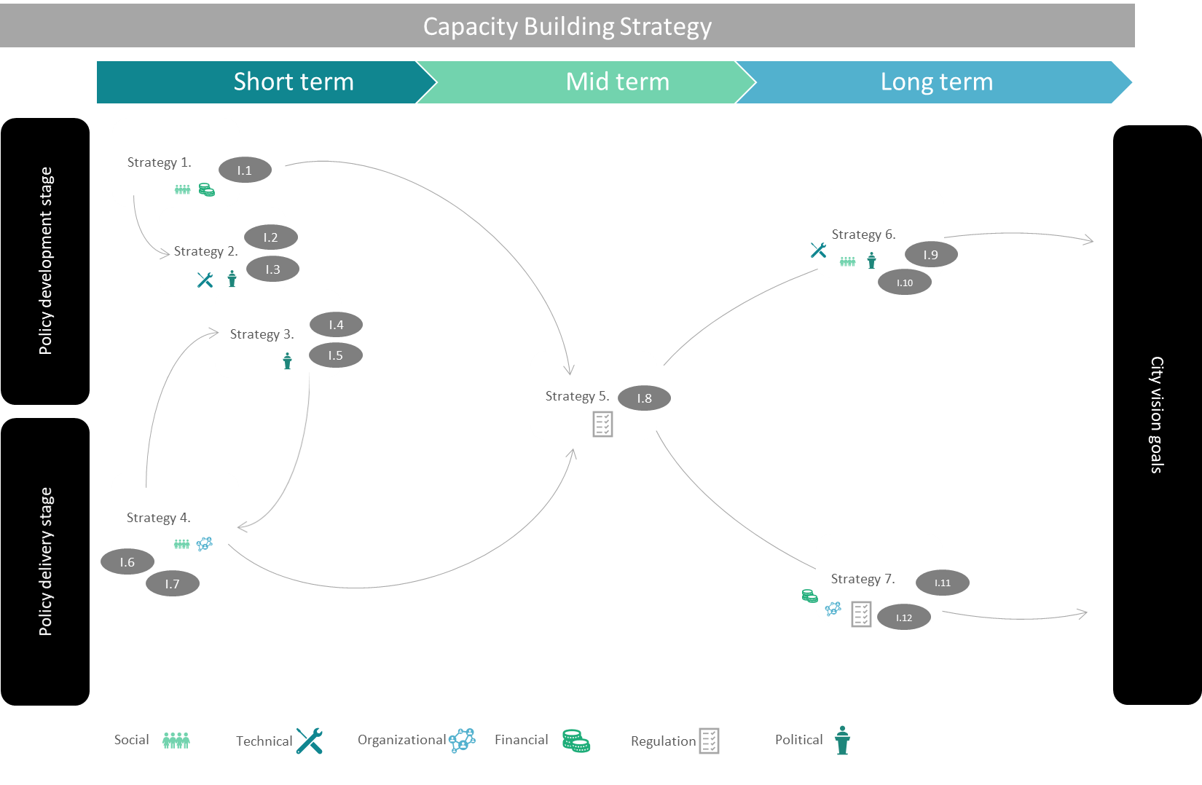

Slide 13
Remarks
Beyond the Action Plans for Energy Transition, it is needed to capacitate the cities to put in place expected actions successfully.
Capacity building comprises a complete set of municipal components where is needed to pay attention.
Capacity Building has to be holistic, flexible and specific to the city context, considering their obstacles and strengths.
Municipalities find very useful and close to their reality the work done under capacity building umbrella.

Slide 14



Thank you!
Jannes
Marijn
Arantza

